Slide 1
Deferred Action for Childhood Arrivals (DACA) Training
Presented by:
Mariam Kelly

Slide 2
What is Deferred Action for Childhood Arrivals?
An executive order signed in June 2012 by President Obama
Allows undocumented individuals who were brought to the United States (U.S.) as children to be safe from deportation and to work legally in the U.S.
Will not be placed into removal proceedings or removed from the U.S. for 2 years from the date of being granted deferred action (unless terminated)
Eligible to work legally in the U.S. with an employment authorization card (EAD)
Can apply for state ID cards, driver’s licenses, and Social Security cards

Slide 3
Who is eligible for DACA?
Must prove through documentary evidence that:
Arrived in the U.S. before turning 16, and before June 15, 2007
Have resided in U.S. continuously since June 15, 2007 - June 15, 2012 and through to present day
Were born after June 15, 1981 (aged 30 or under as of June 15, 2012), and at least 15 years old
Currently be in school, have graduated from high school, have obtained a general education development certificate, or are honorably discharged veterans of the Coast Guard or Armed Forces of the U.S.
Have not been convicted of a felony offense, a significant misdemeanor offense, multiple misdemeanor offenses, or otherwise pose a threat to national security or public safety.

Slide 4
Initial (First-Time) DACA Requests

Slide 5
What forms should be included in a DACA application?
USCIS Forms:
I-821D: Consideration of Deferred Action for Childhood Arrivals (form updated June 4, 2014)
I-765: Application for Employment Authorization
I-765WS: Employment Authorization Worksheet
G-1145: E-Notification of Application/Petition Acceptance

Slide 6
I-821 D
Must use most recent version of the form (6/4/2014)
List name of client exactly as it appears on identity document (passport, birth certificate).
Include both last names. Do not add hyphen unless it appears on identity document that way.
Education Information: if client is currently in high school, list date of last attendance (likely same day as clinic)
Preparer Information: List your name, Business/Organization name is FREE DACA CLINIC, sign your own name (stickers provided for address, phone, etc.)
Interpreter Information: List Interpreter’s contact information if client is not a fluent English speaker

Slide 7
I-765
Q. 9: False Social Security Numbers- DON’T include them
On I-765 and supporting documentation for continuous physical presence
Qs. 12-14: Manner of Entry:
B1/B2 Visa
Entry with tourist visa; or
No Lawful Status
Covers Entry without Inspection, Entry with Fraudulent Documents, Waive-Through Checkpoint
Q. 15: Current Status: No Lawful Status- DACA Applicant
Q. 16: Eligibility Category: (c)(33)

Slide 8
I-765 Worksheet (WS) & G-1145
I-765 Worksheet
Must be included
Does not require signature
Does not require supporting documentation
Numbers need not be exact
G-1145: E-Notification of Application/Petition Acceptance
Optional form
Does not require signature
Allows applicant to get an email or text from USCIS when application is received by USCIS
USCIS may use this as a tool to notify people about the future renewal dates, other issues

Slide 9
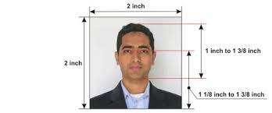
What else should be included?
Finished DACA application package includes:
Cover Letter
Forms
Supporting Documents, sorted by color page separators
Proof of Age and Identity
Proof of Educational Requirement
Proof of Continuous Physical Presence (2007-Present)
2 U.S. passport photos (name and date of birth on back in felt pen)
Money order for $465, made payable to U.S. Department of Homeland Security (check with CLSEPA staff if client expresses inability to pay fee)

Slide 10
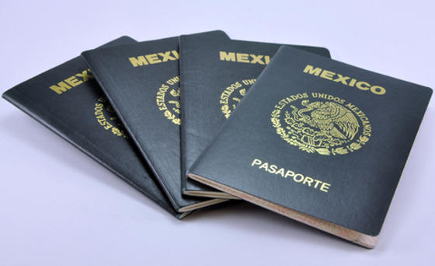
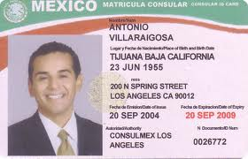
Proving Age and Identity
Copy of Birth Certificate with Certified English translation
Copy of Passport from Applicant’s country of citizenship
Other government-issued photo identification, such as Matricula Consular
Student Identification card (issued by school, with photo)

Slide 11
Proving Educational Requirement
Copy of High School Diploma
Copy of school transcript (if still in high school)
Copy of GED Equivalency Certificate
Proof of enrollment in GED program (personalized letter from program proving enrollment, copy of class schedule with Applicant’s name and date)
Proof of enrollment in classes to build skills for GED (i.e. English as a Second Language classes)

Slide 12
Proving Continuous Physical Presence
School transcripts, report cards, schedules, awards, certificates, ID cards, class photos with names/dates
Medical records: vaccination records, log of doctor visits, hospital stays, dental records, prescriptions in client’s name
Tax returns (so long as Applicant’s name appears somewhere)
Bills, receipts, tickets, photo badges, dated photographs
If nothing else available: affidavits, declarations from trusted sources, social media (i.e. location check-ins)
If any absence from US: provide details in addendum

Slide 13
Simple DACA vs. Complex DACA: What will you see at a clinic?
Simple Cases
Complex Cases
Tend to be done in groups (clinics/workshops) or pro se
Clean record, no immigration violations, no former deportation order, no contact with Immigration and Customs Enforcement
Fairly straightforward, high grant rate, are usually processed quicker
Arrest history: juvenile arrest, minor arrest as an adult
Immigration violations: outstanding removal order, expedited removal at the U.S. border, voluntary departure but never departed, possible immigration fraud
Gaps in physical presence
Needs individualized, ongoing representation in event of additional Request for Evidence (RFE) by USCIS
Requires Supervisory Review at USCIS (6 months or more to process)

Slide 14
DACA Renewal Requests

Slide 15
DACA Renewal
A new Form I-821D allowing for renewal applications was issued by USCIS in June 2014
DACA Renewal applicants should file for renewal 120-150 days before expiration of DACA
Okay to accommodate late-filers, but they should send application out via Express Mail as soon as possible
USCIS said it will make every effort to process renewal applications as timely as possible, if made within 120 days of expiration

Slide 16
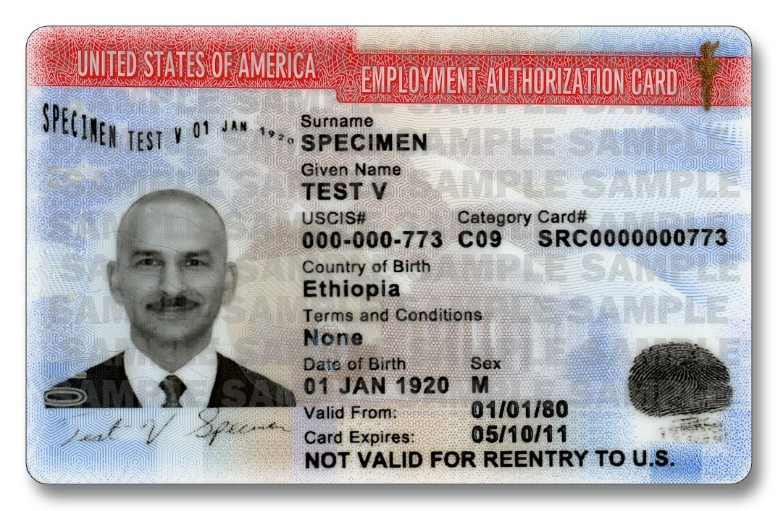
What to Look for on Renewal Applicant’s Previous Employment Authorization Card?
I-765, Q. 16. Eligibility Category: Always (c)(33) for DACA
Alien Registration
Number (A#)
I-765 Q. 11: Which USCIS Office? For DACA card number will start with WAC (California Service Center) or LIN (Nebraska Service Center)
I-765 Q. 11 When DACA was granted: Use Valid from date
DACA Expiration Date, use this for I-821D page 1, Q. 2

Slide 17
DACA Renewal vs. Initial DACA Filing
No Supporting Documentation Necessary, most cases will only need to include the following:
Forms I-821D; I-765; I-765WS, G-1145
Copy of previous EAD card (front and back)
Money Order for $465 payable to U.S. Department of Homeland Security, and 2 passport style photos
Parts of I-821D that you DO NOT need to fill in:
Part 2, p. 3, Address and Travel
Do not list all prior addresses, only new addresses client has lived in since receiving DACA approval
Do fill in Travel Information, don’t forget Questions 8-10
Skip all of Part 3 (end of page 3-page 4)

Slide 18
How do eligibility changes affect DACA renewal?
Travel:
Traveling outside of the U.S. with advance parole is okay, so long as the person traveled within the timeframe granted by USCIS
Traveling outside the U.S. without advance parole automatically terminates DACA. This becomes a complex case- should not be done in a clinic.
Arrests:
DUI, felony, significant misdemeanor, and possibly non-significant misdemeanors can make a person ineligible for DACA Renewal
Any kind of arrest history post-DACA grant: complex case, should not be done in a clinic.
DACA Expired for One Year or More:
If DACA grantee has not applied for renewal one year or more after expiration of employment authorization card, they cannot renew and instead must apply as “initial applicant”

Slide 19
Tips for DACA Clinic
DO urge clients to respect the law and avoid arrests
DO provide certified translations for all non-English documents submitted with application
DO make sure your client has a copy of everything sent to USCIS
DO have your client sign all forms in blue ink
DON’T send any original documents to USCIS
DON’T hesitate to contact CLSEPA if you have any questions
What to Expect at Clinic?
Client paired with 1-2 attorneys/paralegals, interpreter if needed
Forms drafted and printed out, documents organized
CLSEPA Immigration Attorney provides final review of forms and supporting documents
Client mails out application on his/her own (post-clinic instructions given out)

Slide 20
What happens after DACA package is submitted?
Within 2-3 weeks: Receipts arrive for I-821D and I-765
Within 4 weeks: Biometrics Appointment Notice sent to client
Within 3 months: Request for Evidence (if any) sent, or approval (simple cases)
Within 6 months: if no response from USCIS, client can call USCIS Customer Service for more information about processing time
This information is provided to client via
Post-Clinic Instructions sheet.

Slide 21
DACA and Travel
Before DACA Approval:
No travel outside of U.S.
Air travel within U.S. only if person has valid, non-expired state-issued ID
After DACA approval:
Flights within continental U.S., Hawaii, Alaska OK (must have state-issued I.D.)
Travel outside the U.S. (including Puerto Rico, U.S. Virgin Islands)
Must have advance parole approval prior to travel (I-131)
Travel must be for educational, employment, or humanitarian reasons (i.e. study abroad, or dying relative)

Slide 22
Updates on DACA
On November 20, 2014, Pres. Obama announced a series of executive actions, including removing age cap from DACA, extending grant period to 3 years, and introducing DAPA (Deferred Action for Parents).
An injunction has been issued by a district court in Texas which has halted the implementation of the new programs but DOES NOT affect existing DACA as we know it (pursuant to June 15, 2012 announcement).
We expect new programs to eventually move forward– please keep in touch for new pro bono opportunities with expanded DACA and DAPA!
Notes:
As of March 12, 2015, U.S. Department of Justice filed a motion for emergency stay of injunction with the Court of Appeals for the 5th Circuit, but case could go up to Supreme Court.

Slide 23
Questions?
Joyce Song, Esq.
Pro Bono Director & Supervisor of Small Business Program
jsong@clsepa.org
Mariam Kelly, Esq.
Senior Attorney, Immigration Program
mkelly@clsepa.org

